Slide 1
Why Use a DBMS?
Data independence and efficient access.
Reduced application development time.
Data integrity and security. Different users may access different data subsets.
Uniform data administration.
Concurrent access, recovery from crashes.

Slide 2
Stages of Information System
Stage 0: Manual Information System
Records
Files
Index Cards
Stage 1: Sequential Information Systems
Tapes
Files
slow, non-interactive, redundancy,... .
Stage 2: File Based Information Systems
Disk (direct access)
application program has its own file data dependence
data redundancy
Stage 3: DBMS based Information Systems
Generalized data management software
Transaction processing

Slide 3
Files and Databases
File: A collection of records or documents dealing with one organization, person, area or subject (Rowley)
Manual (paper) files
Computer files
Database: A collection of similar records with relationships between the records (Rowley)
Bibliographic, statistical, business data, images, etc.

Slide 4
Is a File System a DBMS?
=
Thought Experiment 1:
You and your project partner are editing the same file.
You both save it at the same time.
Whose changes survive?
A) Yours
B) Partner’s
C) Both
D) Neither
E) ???
Thought Experiment 2:
You’re updating a file.
The power goes out.
Which of your changes survive?
Q: How do you write programs over a subsystem when it promises you only “???” ?
A: Very, very carefully!!
A) All
B) None
C) All Since Last Save
D) ???

Slide 5
Database
Why Database Design Is Important?
A well-designed database facilitates data management and becomes a valuable information generator.
A poorly designed database is a breeding ground for uncontrolled data redundancies.
A poorly designed database generates errors that lead to bad decisions.

Slide 6
Drawbacks of FMS
Uncontrolled Duplication
Wastes space
Hard to update all files
Multiple file formats, duplication of information in different files
Inconsistent data
Inflexibility
Hard to change data
Hard to change programs
Limited data sharing
Poor enforcement of standards
Poor programmer productivity
Excessive program maintenance
Difficulty in accessing data
Need to write a new program to carry out each new task
Data isolation — multiple files and formats

Slide 7
DBMS Benefits
Minimal data redundancy
Consistency of data
Integration of data
Sharing of data
Ease of application development
Uniform security, privacy, and integrity controls
Data accessibility and responsiveness
Data independence
Reduced program maintenance

Slide 8
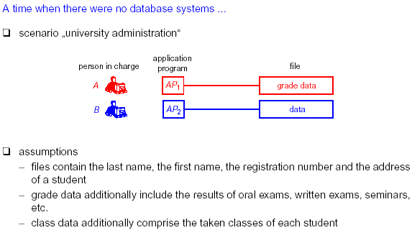

Slide 9
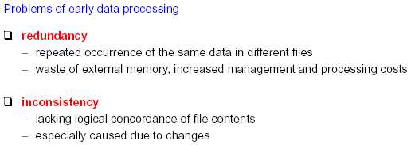

Slide 10
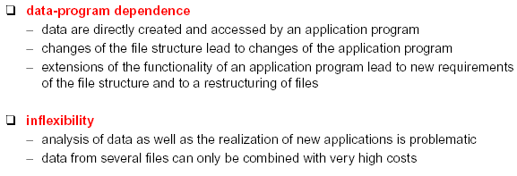

Slide 11
FMS VS DBMS
File System approach
DBMS approach

Slide 12
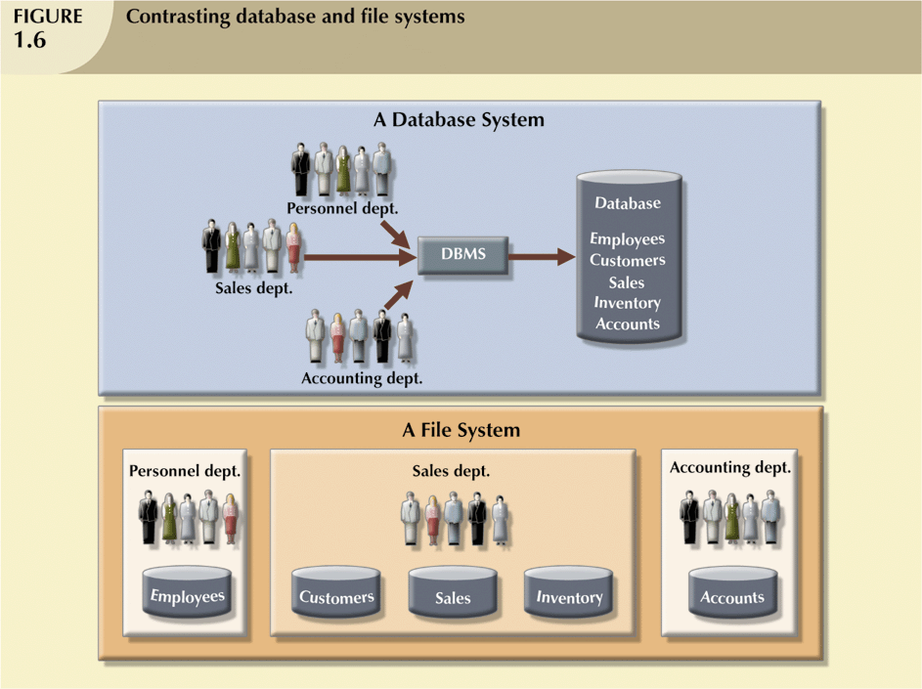
Database vs. File Systems

Slide 13
File Method Problems
Files defined in program
Cannot read file without definition
Hard to find definition
Every time you alter file, you must rewrite code
Change in a program/file will crash other code
Cannot tell which programs use each file
Multiuser problems
Concurrency
Security
Access
Backup & Restore
Efficiency
Indexes
Programmer talent
System
Application

Slide 14
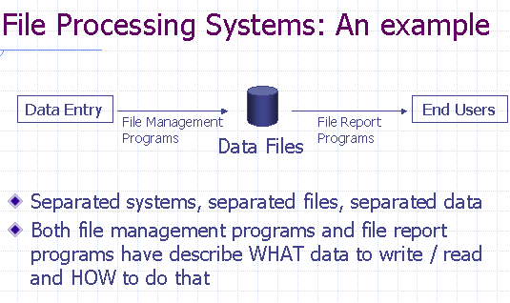

Slide 15
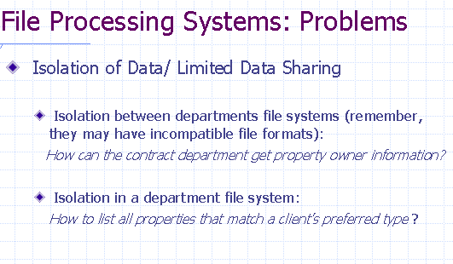

Slide 16
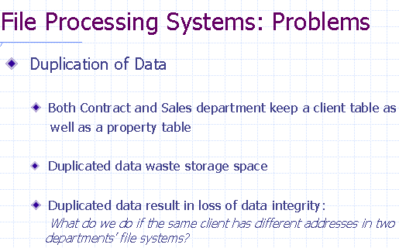

Slide 17
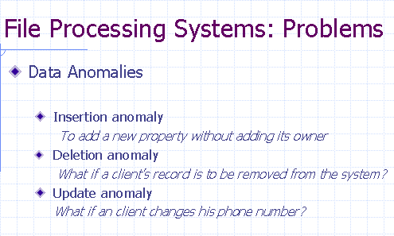

Slide 18
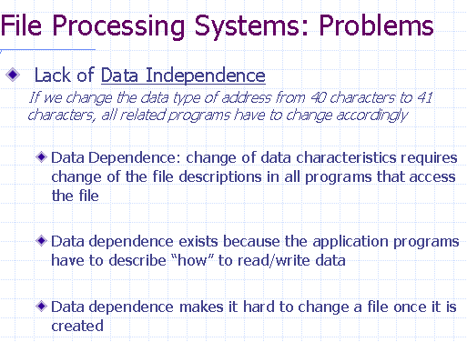

Slide 19
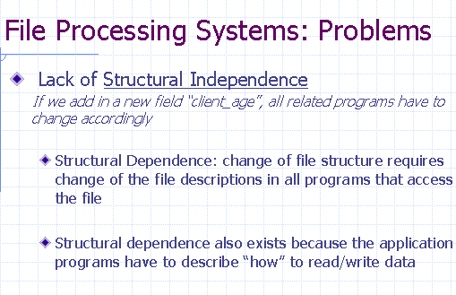

Slide 20
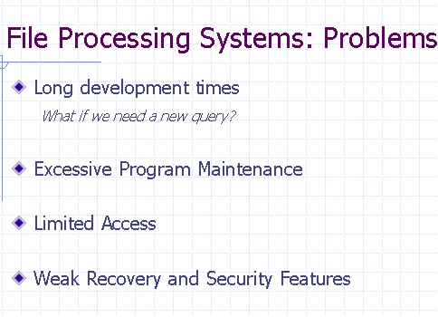

Slide 21
File Based Information Systems
Conventional Data Processing techniques:
Enterprise:
Application Program A
Customer
Application System A
File System A
Application System B
Application Program B
File System B
Invoice
…
Application System N
Application Program N
Inventory
File System N

Slide 22
File Based Information Systems (cont.)
Customer
Invoice
Customer No.
Customer Name
Customer Addr.
Social Security ID
Customer No.
Customer Name
Part No.
Quantities
Unit Price
Inventory
Parts
Part No.
Part Description
Unit Price
Supplier
Quantities Remain
Quantities Ordered
Part No.
Part Description
Supplier
Quantities Ordered
Customer Name
Unit Price

Slide 23
Old File Method/3GL
Programs
Files
Payroll
Data Definition
File 1
…
File 2
…
Pay History
Benefits
Benefits
Data Definition
File A
File 2
File C
…
Employee
Employee
Choices

Slide 24
Example of File Method v DBMS
COBOL
Employee File
File Division
01 Employees
02 ID
02 Name
02 Address
01 Department
02 ID
02 . . .
112 Davy Jones 999 Elm
Street . . . 113 Peter Smith
101 Oak St . . .
Add to file (e.g.Cell phone)
Write code to copy employee file and add empty cell phone slot.
Find all programs that use employee file.
Modify file definitions.
Modify reports (as needed)
Recompile, fix new bugs.
Easier: Keep two employee files?
02 Cell Phone
More programs
File Division
01 Employees
...

Slide 25
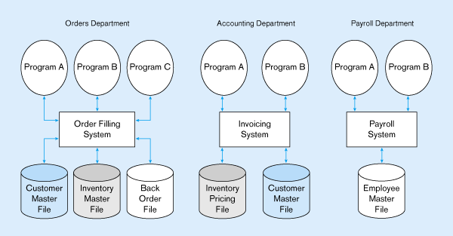
Program-Data Dependencies in FMS
Data Dependence
Change in file’s data characteristics requires modification of data access programs
Lengthy development time
Excessive program maintenance
Structural Dependence
Change in file structure requires modification of related programs

Slide 26
Data Independence in DBMS but not in FMS
Application Program
➔ Data Structure
Immunity of application to change in storage structure and access strategy.

Slide 27
Data Dependence vs. Data Independence
S
S#
S₁
S₂
：
Sn
Data Dependent
e.g. SELECT CITY
FROM S
WHERE ITEM = 'X';
Linked list: TOP
if item = TOP . item then .........
Tree:
.
if item < root.data then root := root.left ..........
Array:
if A[I] = item then ............
Storage structure changed ➔ program changed
S Top
s1
s2
sn

Slide 28
Data Redundancy in FMS
Data Redundancy
Different and conflicting versions of same data
Results of uncontrolled data redundancy
Data anomalies
Modification
Insertion
Deletion
Data inconsistency
Lack of data integrity

Slide 29
Purpose of Database System
In the early days, database applications were built on top of file systems
Drawbacks of using file systems to store data:
Data redundancy and inconsistency
Multiple file formats, duplication of information in different files
Difficulty in accessing data
Need to write a new program to carry out each new task
Data isolation — multiple files and formats
Integrity problems
Integrity constraints (e.g. account balance > 0) become part of program code
Hard to add new constraints or change existing ones

Slide 30
Purpose of Database Systems
Drawbacks of using file systems (cont.)
Atomicity of updates
Failures may leave database in an inconsistent state with partial updates carried out
E.g. transfer of funds from one account to another should either complete or not happen at all
Concurrent access by multiple users
Concurrent accessed needed for performance
Uncontrolled concurrent accesses can lead to inconsistencies
E.g. two people reading a balance and updating it at the same time
Security problems
Database systems offer solutions to all the above problems

Slide 31
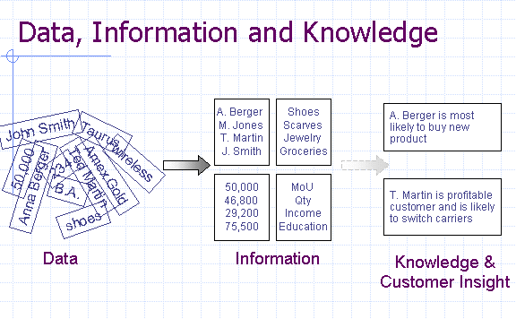

Slide 32
DBMS based Information Systems: Basic Approach - Integration
(1) Integration of Information
Description of the integrated view of data is the "Conceptual Schema" of the database
DBMS
Application
program
End-user

Slide 33
DBMS based Information Systems: Basic Approach – Simple views and High level language
(2) Provide simple views (External Schema) and high level language (e.g. SQL) for users to manipulate (handle) data
High level language: e.g. SQL (Structured Query Language)
<e.g.>: SELECT SNAME
FROM S
WHERE S#= 'S4';
Description of user's view of data is the "external schema" or "subschema" or "view".
High-level languages (Query Language): SQL
(1) Data Definition Language:
define format
(2) Data Manipulation Language:
retrieve, insert, delete, update
Emphasize: EASE OF USE !!
S
S#
name

Slide 34
DBMS based Information Systems: Basic Approach - Storage/Access Method
(3) Efficient Storage/Access Techniques:
implemented once rather than duplicated in all application programs.
User: query in SQL
Language Processor
DBMS
Access Methods Calls
Access Method
(B+ tree, Dynamic Hashing)
I/O calls

Slide 35
DBMS based Information Systems: Basic Approach - Transaction Management
(4) Provide Transaction Management:
Concurrency Control
Recovery
Security
.
:

Slide 36
Example: A Simple Query Processing
Query in SQL：
SELECT CUSTOMER. NAME
FROM CUSTOMER, INVOICE
WHERE REGION = 'N.Y.' AND
AMOUNT > 10000 AND
CUTOMER.C#=INVOICE.C
DBMS
Language Processor
Internal Form :
Π(σ (S SP)
Optimizer
Language
Processor
Operator :
SCAN C using region index, create C
SCAN I using amount index, create I
SORT C?and I?on C#
JOIN C?and I?on C#
EXTRACT name field
Operator Processor
Calls to Access Method：
OPEN SCAN on C with region index
GET next tuple
.
.
.
Access Method
e.g.B-tree; Index;
Hashing
Access
Method
Calls to file system：
GET10th to 25th bytes from
block #6 of file #5
File System
database

Slide 37
Advantages of Database Approach
Minimal data redundancy (Controlled).
Data consistency is maintained.
Integration of data in a single repository.
Improves Data Sharing and Data Quality.
Enforcement of standards (Business Rules).
Ease of application development(.
Uniform security, privacy and integrity.
Structural and Data independence.
Stores data structures, relationships, and access paths
Notes:
Advantages of a DBMS. The DBMS provides a solution to basic data storage and retrieval problems. By using a DBMS to handle data storage problems, programmers can concentrate on building applications—saving time and money in developing new systems and simplifying maintenance of existing applications.

Slide 38
Database Management Approach
Data is most important
Data defined first
Standard format
Access through DBMS
Queries, Reports, Forms
Application Programs
3GL Interface
Data independence
Change data definition without changing code
Alter code without changing data
Move/split data without changing code
All Data
DBMS
Program1
Queries
Reports
Program2
Notes:
DBMS focus on data. First, define the data. Then all queries, reports, and programs access the data through the DBMS. The DBMS always handles common problems such as concurrency and security.

Slide 39
Modifying Data with DBMS
Field Name Data Type Description
EmployeeID Number Autonumber..
TaxpayerID Text Federal ID
LastName Text
FirstName Text
. . .
Phone Text
. . .
CellPhone Text Cellular . . .
Add cell number to employee table
Open table definition
Add data element
If desired, modify reports
Use report writer
No programming
Existing reports, queries, code will all run as before with no changes.
Notes:
Adding cellular phone numbers to the Employee table. Adding a new element to a table does not affect the existing queries, reports, forms or programs.

Slide 40
Summary of Advantages of DBMS
 Sharing of data  Consistency of data  Integrity of data  Security of data  Data independence  Allows for more analysis of the same amount of data  Improved data access and system performance  Potentially increased productivity  Increased concurrency  Improved data backups and recovery

